Slide 1
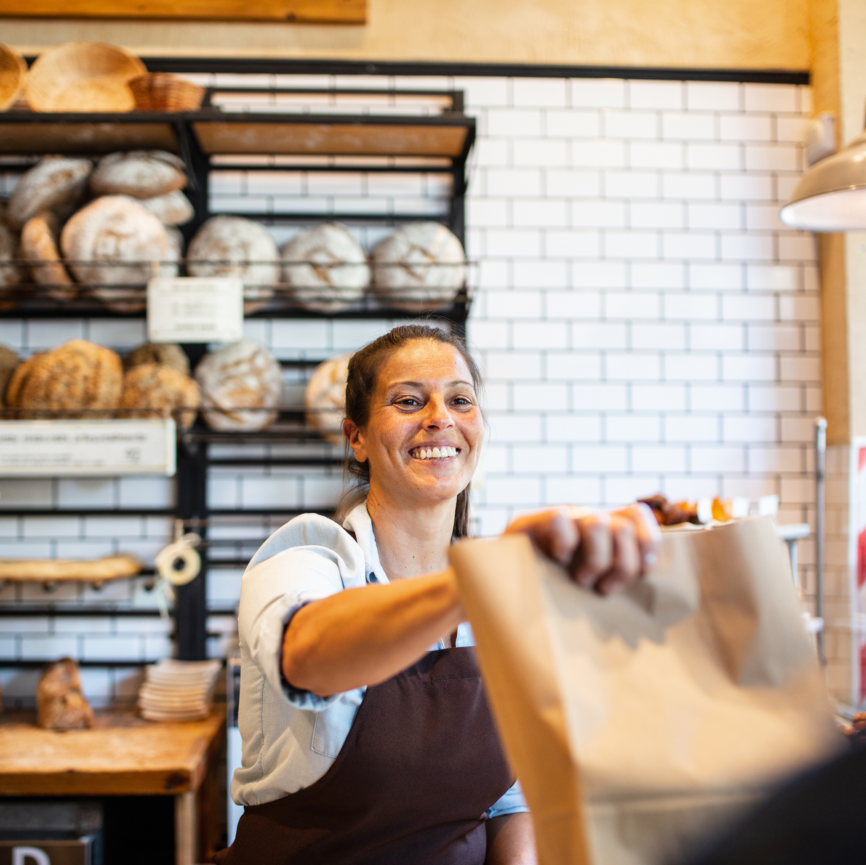
Store Profit Maximization

Slide 2
Agenda
1
2
3
4
5
Problem Statement
Primary Goals
Graphs
Insights
Summary

Slide 3
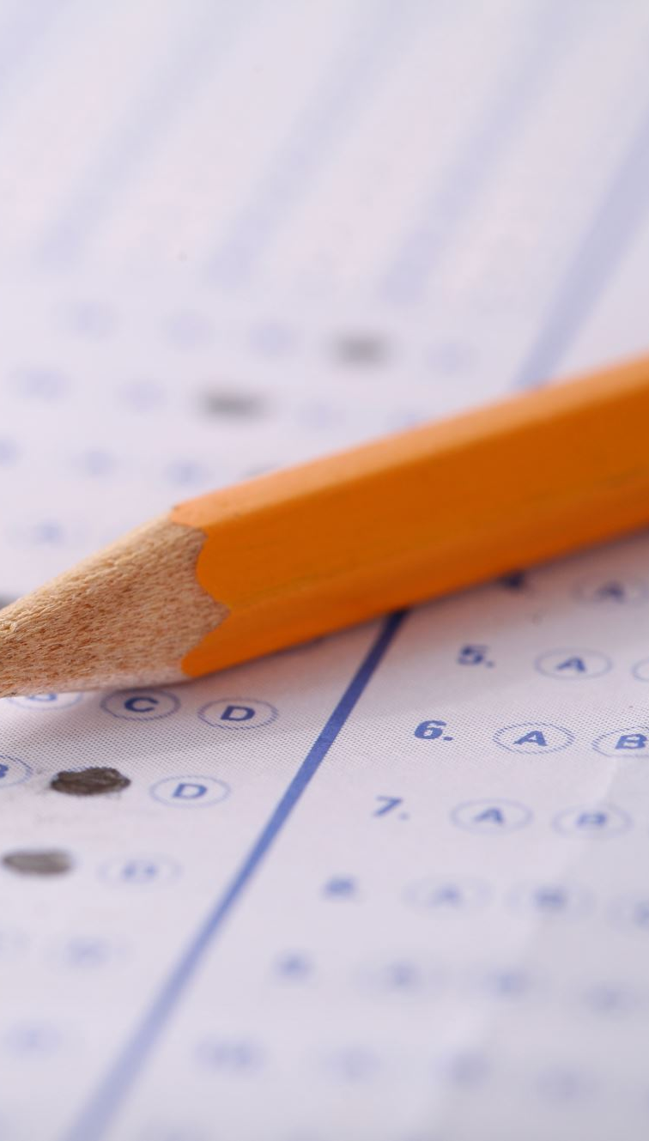
Problem Statement
Store wants to create an annual Sales Report for 2022. So that the store owner can understand their customers and grow more sales in 2023.

Slide 4

Primary goals
Comparing Sales and orders
Relation between Age and Gender based on number of orders
Who purchased more men or women in 2022?
What are different Order Status in 2022?
Top 5 States contributing to the sales
Which channel is contributing maximum to sales?
Highest selling Category?

Slide 5
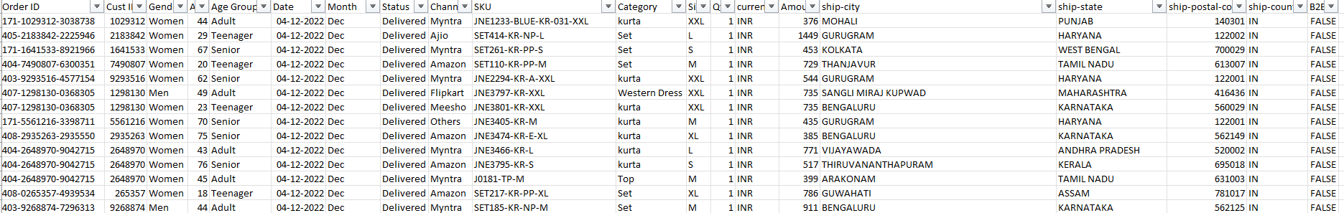
Dataset

Slide 6
Comparing Sales and orders

Slide 7
Orders: Age Vs Gender

Slide 8
Sales: Men Vs Women

Slide 9
Order: Status

Slide 10
Sales: top 5 States

Slide 11
Orders: Channels Contributing To Sales

Slide 12
Sales: Highest Category

Slide 13
Insights
Amazon, Flipkart and Myntra
These 3 channels are contributing 80% to the sales
Women purchasing more
buying [64%] than men .
Teenagers Female
With 37% of total sales is made by adult female age between [ below 30]
Order Status: Delivered
92% of orders are delivered
Top states with Sales
Maharashtra, Karnataka and Madhya Pradesh with 35% of total sales in states

Slide 14
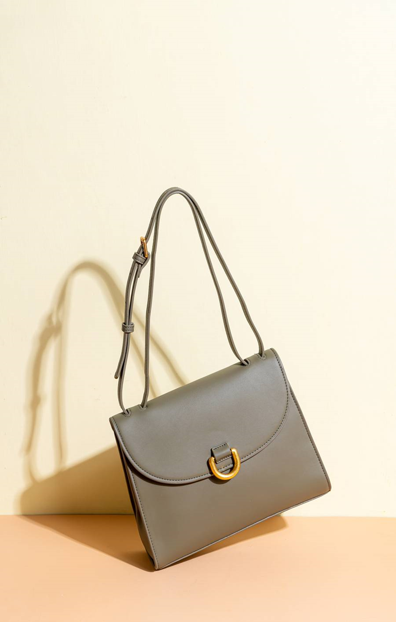
Summary
To improve the sales of the store focus more on women age between 30-49 lives in Maharashtra, Karnataka and Uttar Pradesh by giving them ads/offers/coupons available on Amazon, Flipkart and Myntra.

Slide 15
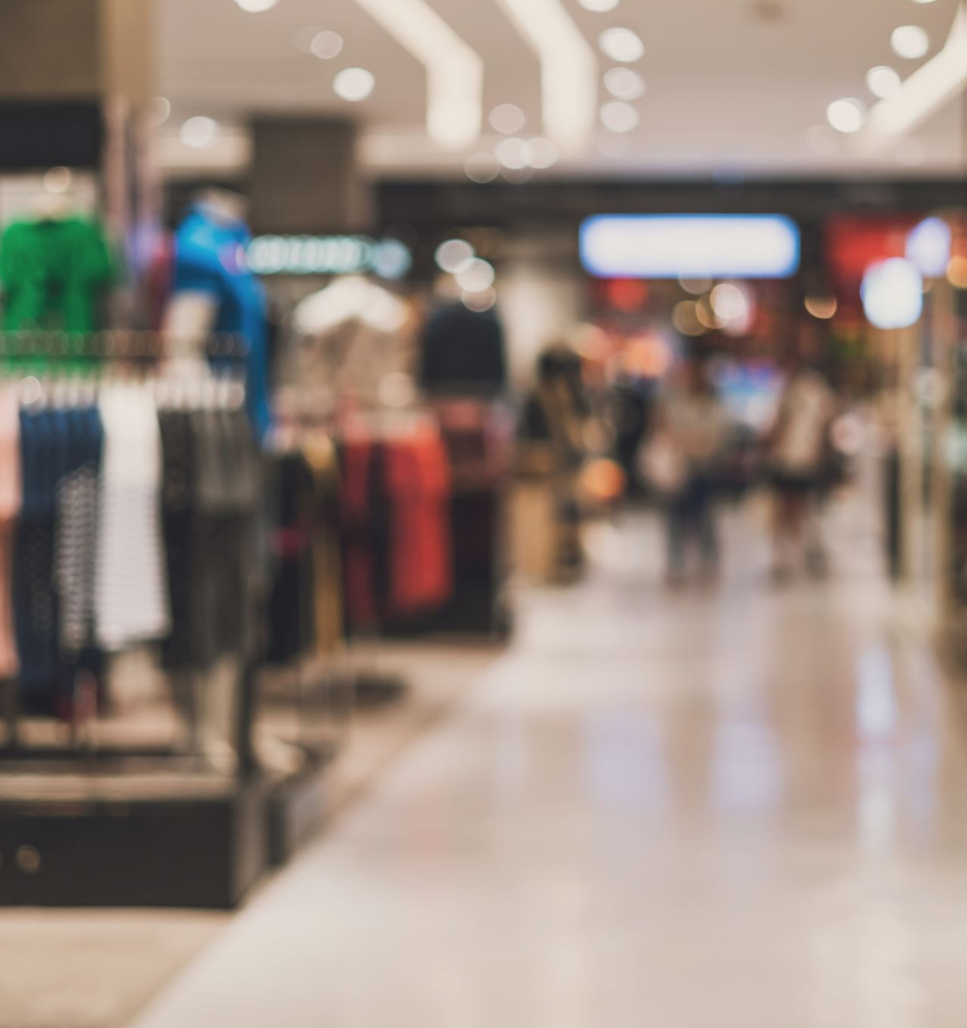
Thank you
Shahzad Azeez
shahzadazeez05@gmail.com

